Slide 1
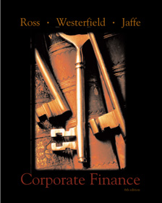
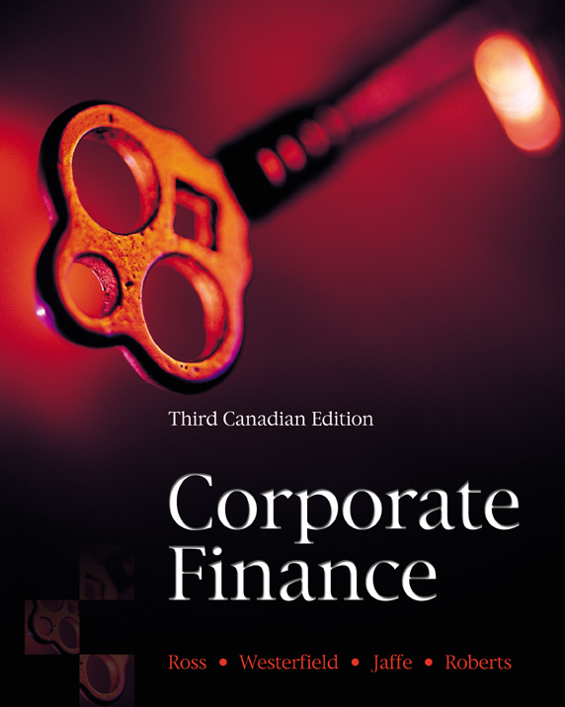
Chapter Twenty Seven
27
Short-Term Finance and Planning
Corporate Finance
Ross • Westerfield • Jaffe
Sixth Edition
Prepared by
Gady Jacoby
University of Manitoba
and
Sebouh Aintablian
American University of Beirut

Slide 2
Chapter Outline
27.1 Tracing Cash and Net Working Capital
27.2 Defining Cash in Terms of Other Elements
27.3 The Operating Cycle and the Cash Cycle
27.4 Some Aspects of Short-Term Financial Policy
27.5 Cash Budgeting
27.6 The Short-Term Financial Plan
27.7 Summary & Conclusions

Slide 3
Executive Summary
We are solidly into the third great question of corporate finance.
  How much short-term cash flow does a company need to pay its bills?
This chapter introduces the basic elements of short-term financial decisions:
  It describes the short-term operating activities of the firm
  It identifies alternative short-term financial policies
  It outlines the basic elements in a short-term financial plan
  It describes short-term financing instruments

Slide 4
The Balance-Sheet Model of the Firm
The Capital Budgeting Decision
Current Assets
Current Liabilities
Long-Term Debt
Fixed Assets
1 Tangible
2 Intangible
  What long-term investments should the firm engage in?
Shareholders’ Equity

Slide 5
The Balance-Sheet Model of the Firm
The Capital Structure Decision
Current Assets
Current Liabilities
Long-Term Debt
How can the firm raise the money for the required investments?
Fixed Assets
1 Tangible
2 Intangible
Shareholders’ Equity

Slide 6
The Balance-Sheet Model of the Firm
The Net Working Capital Investment Decision
Current Assets
Current Liabilities
Net Working Capital
Long-Term Debt
  How much short-term cash flow does a company need to pay its bills?
Fixed Assets
1 Tangible
2 Intangible
Shareholders’ Equity

Slide 7
27.1 Tracing Cash and Net Working Capital
Current Assets are cash and other assets that are expected to be converted to cash with the year.
  Cash
  Marketable securities
  Accounts receivable
  Inventory
Current Liabilities are obligations that are expected to require cash payment within the year.
  Accounts payable
  Accrued wages
  Taxes

Slide 8
27.2 Defining Cash in Terms of Other Elements
Long-Term Debt
Net Working Capital
Fixed Assets
+
=
+
Equity
Other Current Assets
Net Working Capital
Current Liabilities
=
Cash
–
+
Long-Term Debt
Net Working Capital (excluding cash)
Fixed Assets
Cash
=
+
Equity
–
–

Slide 9
27.2 Defining Cash in Terms of Other Elements
Long-Term Debt
Net Working Capital (excluding cash)
Fixed Assets
Cash
=
+
Equity
–
–
An increase in long-term debt and or equity leads to an increase in cash—as does a decrease in fixed assets or a decrease in the non-cash components of net working capital.
The Sources and Uses of Cash Statement follows from this reasoning.

Slide 10
27.3 The Operating Cycle and the Cash Cycle
Raw material purchased
Cash received
Finished goods sold
Order Placed
Stock Arrives
Inventory period
Accounts receivable period
Time
Accounts payable period
Firm receives invoice
Cash paid for materials
Operating cycle
Cash cycle

Slide 11
27.3 The Operating Cycle and the Cash Cycle
Accounts payable period
Cash cycle
=
Operating cycle
–
In practice, the inventory period, the accounts receivable period, and the accounts payable period are measured by days in inventory, days in receivables, and days in payables.

Slide 12
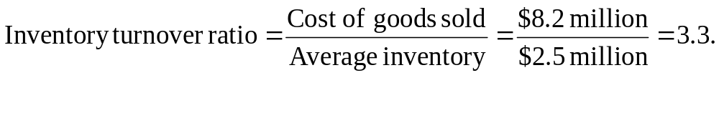
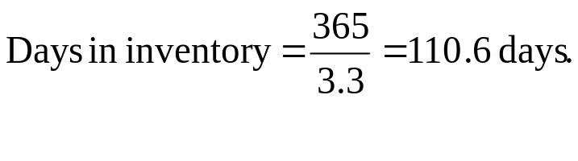
The Operating Cycle and the Cash Cycle: An Example
Consider the balance sheet and income statement for Tradewinds Manufacturing shown in Table 27.1.
The operating cycle and the cash cycle can be determined for Tradewinds after calculating the appropriate ratios for inventory, receivables, and payables.

Slide 13
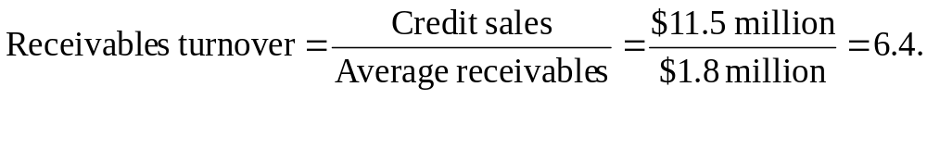
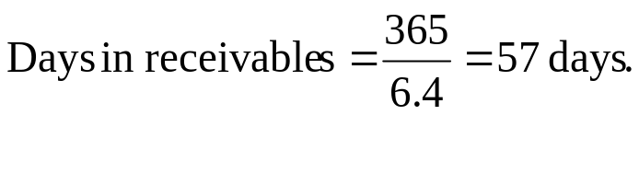
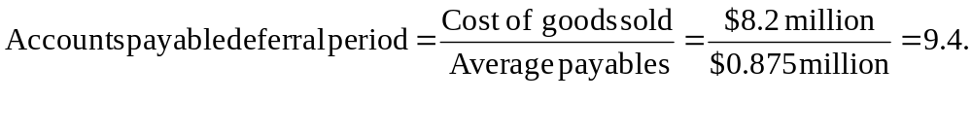
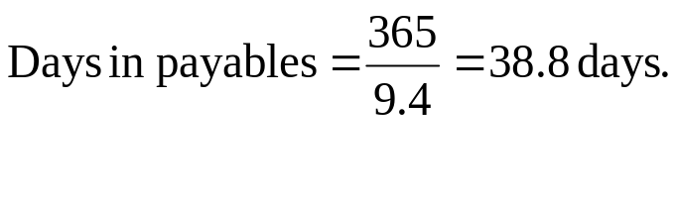
The Operating Cycle and the Cash Cycle: An Example (continued)

Slide 14
The Operating Cycle and the Cash Cycle: An Example (continued)
Operating cycle = Days in inventory + Days in receivables
= 110.6 days + 57 days = 167.6 days.
Cash cycle = Operating cycle – Days in payable
= 167.6 days – 38.8 days.

Slide 15
Interpreting the Cash Cycle
The cash cycle increases as the inventory and receivables periods get longer.
The cash cycle decreases if the company is able to stall payment of payables by lengthening the payables period.
The cash cycle is related to profitability and sustainable growth.
  Increased inventories and receivables that may cause a cash cycle problem will also reduce total asset turnover and result in lower profitability.
  The total asset turnover is directly linked to sustainable growth (Ch.26): reducing total asset turnover lowers sustainable growth.

Slide 16
27.4 Some Aspects of Short-Term Financial Policy
There are two elements of the policy that a firm adopts for short-term finance.
  The Size of the Firm’s Investment in Current Assets
  Usually measured relative to the firm’s level of total operating revenues.
    Flexible
    Restrictive
  Alternative Financing Policies for Current Assets
  Usually measured as the proportion of short-term debt to long-term debt.
    Flexible
    Restrictive

Slide 17
The Size of the Investment in Current Assets
A flexible policy short-term finance policy would maintain a high ratio of current assets to sales.
  Keeping large cash balances and investments in marketable securities.
  Large investments in inventory.
  Liberal credit terms.
A restrictive short-term finance policy would maintain a low ratio of current assets to sales.
  Keeping low cash balances, no investment in marketable securities.
  Making small investments in inventory.
  Allowing no credit sales (thus no accounts receivable).

Slide 18
Carrying Costs and Shortage Costs
$
Total costs of holding current assets.
Minimum point
Carrying costs
Shortage costs
CA*
Investment in Current Assets ($)

Slide 19
Appropriate Flexible Policy
$
Total costs of holding current assets.
Carrying costs
Minimum point
Shortage costs
CA*
Investment in Current Assets ($)

Slide 20
When a Restrictive Policy is Appropriate
$
Minimum point
Total costs of holding current assets.
Carrying costs
Shortage costs
CA*
Investment in Current Assets ($)

Slide 21
Alternative Financing Policies for Current Assets
A flexible short-term finance policy means low proportion of short-term debt relative to long-term financing.
A restrictive short-term finance policy means high proportion of short-term debt relative to long-term financing.

Slide 22
Alternative Financing Policies for Current Assets
In an ideal world, short-term assets are always financed with short-term debt and long-term assets are always financed with long-term debt.
In this world, net working capital is always zero.

Slide 23
Financing Policy for an Idealized Economy
Current assets = Short-term debt
$
Long-term debt plus common stock
Fixed assets: a growing firm
0 1 2 3 4 5
Time
Grain elevator operators buy crops after harvest, store them, and sell them during the year. Inventory is financed with short-term debt. Net working capital is always zero.

Slide 24
A Remark on Short-term Financing
Maturity mismatching produces rollover risk, the risk that reduced short-term financing may not be available.
An example is the financial distress faced in 1992 by Olympia and York (O and Y), a real estate development firm.
  O and Y’s main assets were office towers.
  Financing for these long-term assets was short-term bank loans and commercial paper.
  In 1992, investor fears about real estate prospects prevented O and Y from rolling over its commercial paper.
  The crises pushed O and Y into financial crisis and bankruptcy.

Slide 25
Current Assets and Liabilities in Practice
Advances in technology are changing the way Canadian firms manage their assets.
With new techniques, such as just-in-time inventory and business-to-business (B2B) sales, industrial firms are moving away from flexible policies and toward a more restrictive approach to current assets.
Current liabilities are also declining as a percentage of total assets.
Firms are practising maturity hedging as they match lower current liabilities with decreased current assets.

Slide 26
27.5 Cash Budgeting
A cash budget is a primary tool of short-run financial planning.
The idea is simple: Record the estimates of cash receipts and disbursements.
Cash Receipts
  Arise from sales, but we need to estimate when we actually collect.
Cash Outflow
  Payments of Accounts Payable
  Wages, Taxes, and other Expenses
  Capital Expenditures
  Long-Term Financial Planning

Slide 27
27.5 Cash Budgeting
The cash balance tells the manager what borrowing is required or what lending will be possible in the short run.
The cash balance figures for Fun Toys appear in Table 27.6.
Fun Toys had established a minimum cash balance of $5 million to facilitate transactions and to protect against unexpected contingencies.

Slide 28
The Short-term Financial Plan/Risks
There are tools for assessing the degree of forecasting risks and identifying their components that are most critical to a financial plan’s success or failure.
For example, Air Canada uses simulation analysis in forecasting its cash needs. The simulation is useful in capturing the variability of cash flow components in Canada’s airline industry.

Slide 29
The Short-term Financial Plan/Short-term Borrowing
Example: Chapters Online
  The firm’s internet division sold books, CD-Roms, DVDs, and videos through its website.
  In September1999, the company went public, raising equity at an offering price of $13.5/share.
  In August 2000, analysts calculated Chapters Online’s “burn rate,” the rate at which the firm was using cash, to determine its cash position.
  The stock price had fallen from the offering price of $13.5 to $2.80 per share within a year.
  Analysts focused on the availability of short-term borrowing to improve the firm’s financial position.

Slide 30
27.6 The Short-Term Financial Plan (continued)
The most common way to finance a temporary cash deficit is to arrange a short-term, operating loan.
Operating loans can be either unsecured or secured by collateral.
Secured Loans
  Accounts receivable financing can be either assigned or factored.
  Securitized receivables, is a new approach to receivables financing. For example, Sears Canada Ltd. sold its receivables to Sears Canada Receivables Trust (SCRT). SCRT issued debentures and commercial paper backed by a diversified portfolio of receivables.
  Inventory loans use inventory as collateral.

Slide 31
27.6 The Short-Term Financial Plan (continued)
Other Sources
  Commercial paper:
    Commercial paper: consists of short-term notes issued by large and highly rated firms.
    Firms issuing commercial paper in Canada generally have borrowing needs over $20 million.
    Dominion Bond Rating Service rates commercial paper similarly to bonds.
  Banker’s acceptances:
    Banker’s acceptances are a variant of commercial paper.
    Banker’s acceptances are more widely used than commercial paper in Canada because Canadian chartered banks enjoy stronger credit ratings than all but the largest corporations.

Slide 32
27.7 Summary & Conclusions
This chapter introduces the management of short-term finance.
  We examine the short-term uses and sources of cash as they appear on the firm’s financial statements.
  We see how current assets and current liabilities arise in the short-term operating activities and the cash cycle of the firm.
  From an accounting perspective, short-term finance involves net working capital.

Slide 33
27.7 Summary & Conclusions
Managing short-term cash flows involves the minimization of costs.
The two major costs are:
  Carrying costs—the interest and related costs incurred by overinvesting in short-term assets such as cash.
  Shortage costs—the cost of running out of short-term assets.
The objective of managing short-term finance and short-term financial planning is to find the optimal tradeoff between these two costs.

Slide 34
27.7 Summary & Conclusions
In an ideal economy, the firm could perfectly predict its short-term uses and sources of cash and net working capital could be kept at zero.
In the real world, net working capital provides a buffer that lets the firm meet its ongoing obligations.
The financial manager seeks the optimal level of each of the current assets.

Slide 35
27.7 Summary & Conclusions
The financial manager can use the cash budget to identify short-term financial needs.
The cash budget tells the manager what borrowing is required or what lending will be possible in the short run.
The firm has available to it a number of possible ways of acquiring funds to meet short-term shortfalls, including unsecured and secured loans.

